Slide 1
Software process model

Slide 2
Software Process Model
Process models prescribe a distinct set of activities, actions, tasks, milestones, and work products required to engineer high quality software.
Process models are not perfect but provide roadmap for software engineering work.
Software models provide stability, control, and organization to a process that if not managed can easily get out of control
Software process models are adapted to meet the needs of software engineers and managers for a specific project.
Software Engineering Process Models: Link 1
Software Engineering Process Models: Link 2

Slide 3
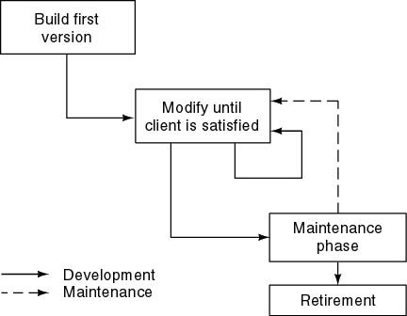
Build and Fix Model

Slide 4
Build and Fix Model
The earlier approach
Product is constructed without specification or any attempt at design.
developers simply build a product that is reworked as many times as necessary to satisfy the client.
model may work for small projects but is totally unsatisfactory for products of any reasonable size.
Maintenance is high.
Source of difficulties and deficiencies
impossible to predict
impossible to manage

Slide 5
Why are Models needed?
Symptoms of inadequacy: the software crisis
scheduled time and cost exceeded
user expectations not met
poor quality

Slide 6
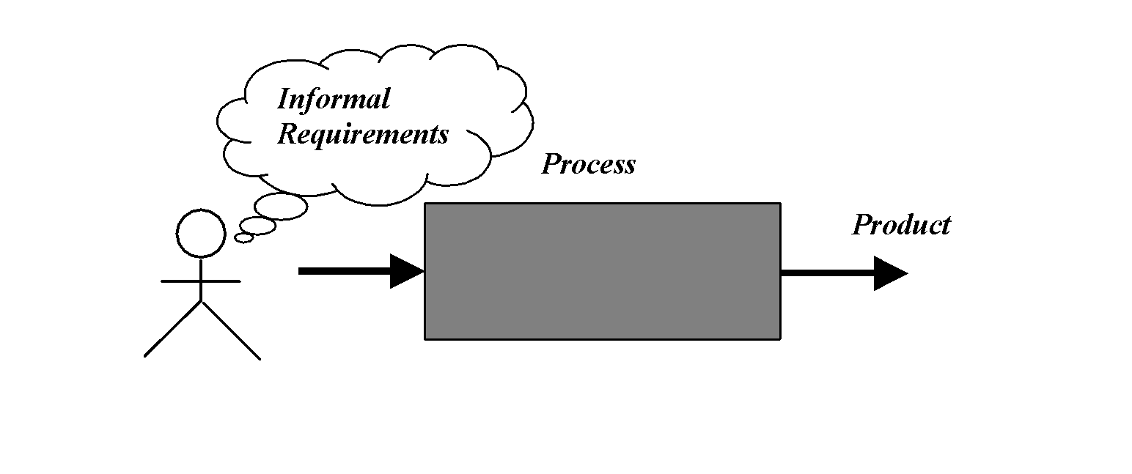
Process as a "black box"
Quality?
Uncertain /
Incomplete requirement
In the beginning

Slide 7
Problems
The assumption is that requirements can be fully understood prior to development
Interaction with the customer occurs only at the beginning (requirements) and end (after delivery)
Unfortunately, the assumption almost never holds

Slide 8
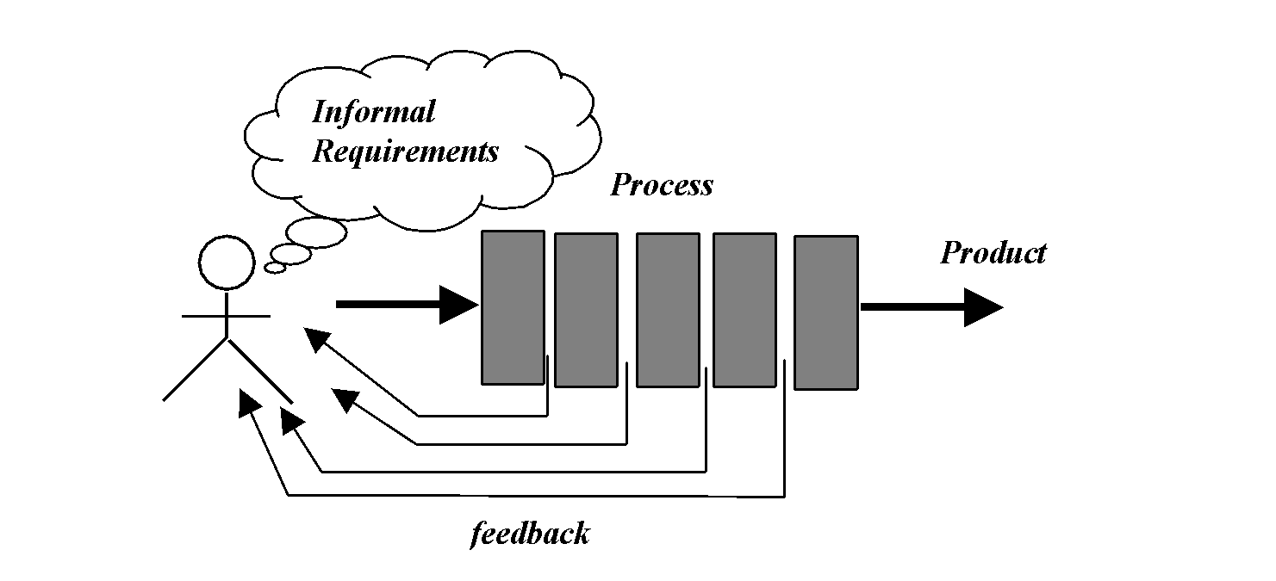
Process as a "white box"

Slide 9
Advantages
Reduce risks by improving visibility
Allow project changes as the project progresses
based on feedback from the customer

Slide 10
Prescriptive Model
Prescriptive process models advocate an orderly approach to software engineering
Organize framework activities in a certain order
Each action in terms of a task set that identifies the work to be accomplished to meet the goals.
Software engineer choose process framework that includes activities like;
Communication
Planning
Modeling
Construction
Deployment

Slide 11
Prescriptive Model
Communication - Before any technical work can commence, it is critically important to communicate and collaborate with the customer (and other stakeholders).
The intent is to understand stakeholders’ objectives for the project and to gather requirements that help define software features and functions.
Planning - A software project is a complicated journey, and the planning activity creates a “map” that helps guide the team as it makes the journey.
The map—called a software project plan—defines the software engineering work by describing the technical tasks to be conducted, the risks that are likely, the resources that will be required, the work products to be produced, and a work schedule.

Slide 12
Prescriptive Model
Modeling - Whether you’re a landscaper, a bridge builder, an aeronautical engineer, a carpenter, or an architect, you work with models every day.
You create a “sketch” of the thing so that you’ll understand the big picture—what it will look like architecturally, how the constituent parts fit together, and many other characteristics.
If required, you refine the sketch into greater and greater detail in an effort to better understand the problem and how you’re going to solve it.

Slide 13
Prescriptive Model
A software engineer does the same thing by creating models to better understand software requirements and the design that will achieve those requirements.
Construction - What you design must be built. This activity combines code generation (either manual or automated) and the testing that is required to uncover errors in the code.
Deployment - The software (as a complete entity or as a partially completed increment) is delivered to the customer who evaluates the delivered product and provides feedback based on the evaluation.

Slide 14
Prescriptive Model
Calling this model as “Prescribe” because it recommend a set of process elements, activities, action task, work product & quality.
Each elements are interrelated to one another (called workflow).

Slide 15
Waterfall Model

Slide 16
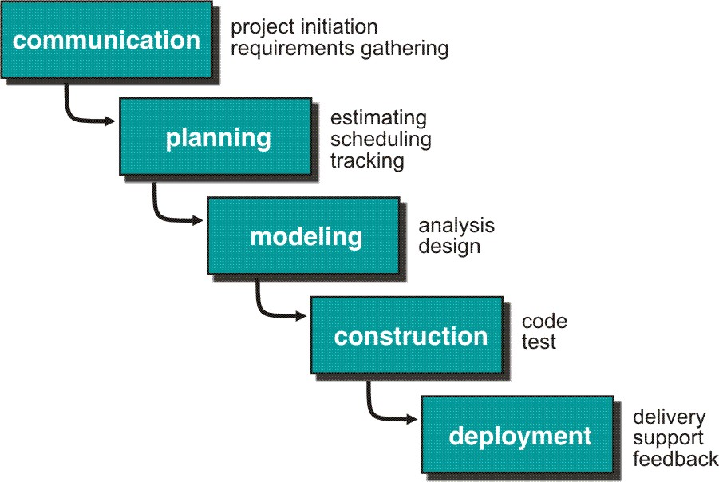
Waterfall Model
Click here to watch a video on Waterfall Model

Slide 17
Waterfall Model
Requirement Gathering and Planning:
All possible requirements of the system to be developed are captured in this phase and documented in a requirement specification doc.
It is performed by the senior members of the team with inputs from the customer, the sales department, market surveys, and domain experts in the industry.
This information is then used to plan the basic project approach and to conduct a product feasibility study in the economical, operational, and technical areas.

Slide 18
Waterfall Model
Planning for the quality assurance requirements and identification of the risks associated with the project is also done in the planning stage.
The outcome of the technical feasibility study is to define the various technical approaches that can be followed to implement the project successfully with minimum risks.

Slide 19
Waterfall Model
System Design (Modeling):
Software Requirement Specification (SRS) document which consists of all the product requirements to be designed and developed during the project life cycle.
The requirement specifications from the first phase are studied in this phase and the system design is prepared.
System Design helps in specifying hardware and system requirements and helps in defining overall system architecture.
Click here to watch ‘How to prepare SRS document’ for software project
Click here to learn about ‘the guidelines to write an SRS document’

Slide 20
Waterfall Model
Designing the product architecture (Modeling)
SRS is the reference for product architects to come out with the best architecture for the product to be developed.
Based on SRS, usually more than one design approach for the product architecture is proposed and documented in a DDS - Design Document Specification.
A design approach clearly defines all the architectural modules of the product along with its communication and data flow representation with the external and third-party modules (if any).
The internal design of all the modules of the proposed architecture should be clearly defined with the minutest of details in DDS.

Slide 21
Waterfall Model
Implementation (Construction):
With inputs from system design, the system is first developed in small programs called units, which are integrated into the next phase.
Each unit is developed and tested for its functionality which is referred to as Unit Testing.
The programming code is generated as per DDS during this stage. If the design is performed in a detailed and organized manner, code generation can be accomplished without much hassle.

Slide 22
Waterfall Model
Integration and Testing (Construction):
All the units developed in the implementation phase are integrated into a system after testing each unit.
This stage refers to the testing-only stage of the product where product defects are reported, tracked, fixed, and retested until the product reaches the quality standards defined in the SRS.
Post integration the entire system is tested for any faults and failures.

Slide 23
Waterfall Model
Deployment of system:
Once the functional and nonfunctional testing is done, the product is deployed in the customer environment or released into the market.
Sometime product deployment happens in stages as per the organizations. business strategy.
The product may first be released in a limited segment and tested in the real business environment (UAT- User acceptance testing).

Slide 24
Waterfall Model
Maintenance (Deployment):
Then based on the feedback, the product may be released as it is or with suggested enhancements in the targeting market segment. After the product is released in the market, its maintenance is done for the existing customer base.
Also, to enhance the product some better versions are released. Maintenance is done to deliver these changes in the customer environment.

Slide 25
Waterfall Model-Applications
Every software developed is different and requires a suitable SDLC approach to be followed based on the internal and external factors. Some situations where the use of Waterfall model is most appropriate are:
Requirements are very well documented, clear and fixed.
Product definition is stable.
Technology is understood and is not dynamic.
There are no ambiguous requirements.
Ample resources with required expertise are available to support the product.

Slide 26
Waterfall Model-Limitations
Problems:
There is no scope for jumping backward or forward or performing two steps simultaneously.
It has many shortcomings since bugs and errors in the code are not discovered until and unless the testing stage is reached.
This can often lead to wastage of time, money and valuable resources
Difficult for the customer to state all the requirement explicitly.
Assumes patience from customer - working version of program will not available until programs not getting change fully.
Real projects are rarely following the sequential model.

Slide 27
Waterfall Model-Advantages
Its simplistic, systematic and orthodox approach.
It allows for departmentalization and control.
A schedule can be set with deadlines for each stage of development
Product can proceed through the development process model phases one by one.
Development moves from concept, through design, implementation, testing, installation, troubleshooting, and ends up at operation and maintenance.
Each phase of development proceeds in strict order.

Slide 28
Classwork

Slide 29
Classwork
Instructions -
For the following questions, you are allowed to use the lecture slides, notes, any books and even the internet.
But you are not allowed to directly copy/paste from anywhere. Except, of course, standard definitions and/or quotations. This means you have to understand the points and write them in your own words. Type your answers and submit.
I will be running each answer through plagiarism checkers. Plagiarism will lead to a big zero. But everything should be fine as long as you use your own words for answers.
Each answer should be in 200 words or less. You should include sufficient descriptions and / or explanations and examples in your answer.

Slide 30
Classwork
What is a software? Is your favorite computer game also a software? And what about Facebook, is it a software too?
Describe the seven types of software applications. Give examples of each.
“If hardware is the body of an organism, then software is its life.” Do you agree? Discuss.
“Once a software is built for a customer and launched, our duties as a software engineer are done and we can move on to other projects.” Do you agree? Discuss.
What are the attributes of a good software? Describe each attribute.

Slide 31
Classwork
Pick any software of your choice. Argue whether and to what extent the software owns the attributes of a good software.
What is a software process model? Why are models needed?
Do you think that strictly every software needs a well-defined process model? Why or why not?
Let’s say your college wants you to develop a student attendance management software for them. Describe how you would follow the prescriptive model for this job.
“Coding is the most important aspect of software development. Because without it, how will your software even exist?” Do you agree? Explain your answer.

Slide 32
Thank you!

